Slide 1
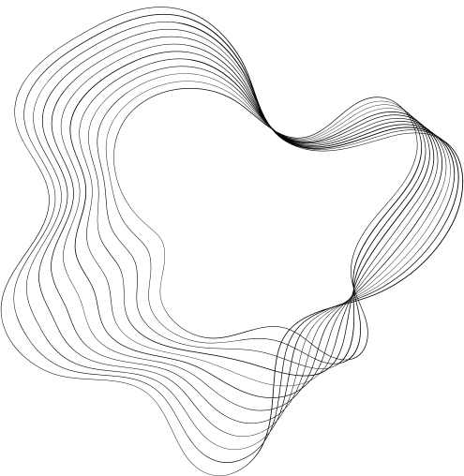

Building LLM Applications
with LangChain
Toma Ijatomi
https://www.linkedin.com/in/toma-ijatomi/

Slide 2

Langchain is a development framework for building LLM applications.

Slide 3

PRESENTATION OUTLINE
01
Components
02
Use Cases
03
Evaluation with LangSmith
04
Agents
05
Resources

Slide 4
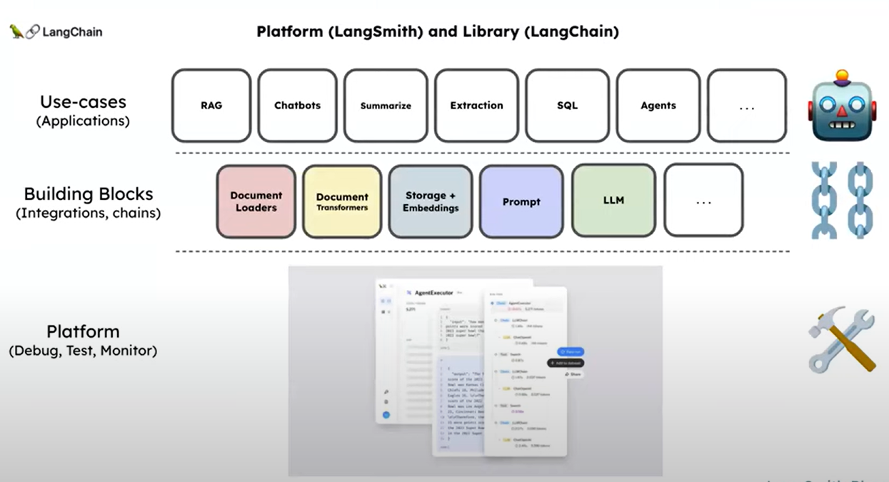
Source – Building LLM Applications with Lance Martin – Software Engineer @ LangChain

Slide 5
Components
Documentation -https://python.langchain.com/v0.2/docs/concepts/#components

Slide 6
Components – Model I/O
Chat Models – 60 integrations
Prompt Templates
LangChain Prompt Hub - Here
Example Selectors
Output Parsers

Slide 7
Components – Retrieval (RAG)
Document Loaders
Text Splitters
Embedding models
Vector stores
Retrievers

Slide 8
Components – Retrieval (RAG)
Document Loaders deal with the specifics of accessing and converting data
Accessing – Websites, Databases, Youtube, arXiv,…..
Data Types – PDF, HTML, JSON, Word, Powerpoint, …..
Returns a list of Document objects
Over 170+ Document loaders

Slide 9
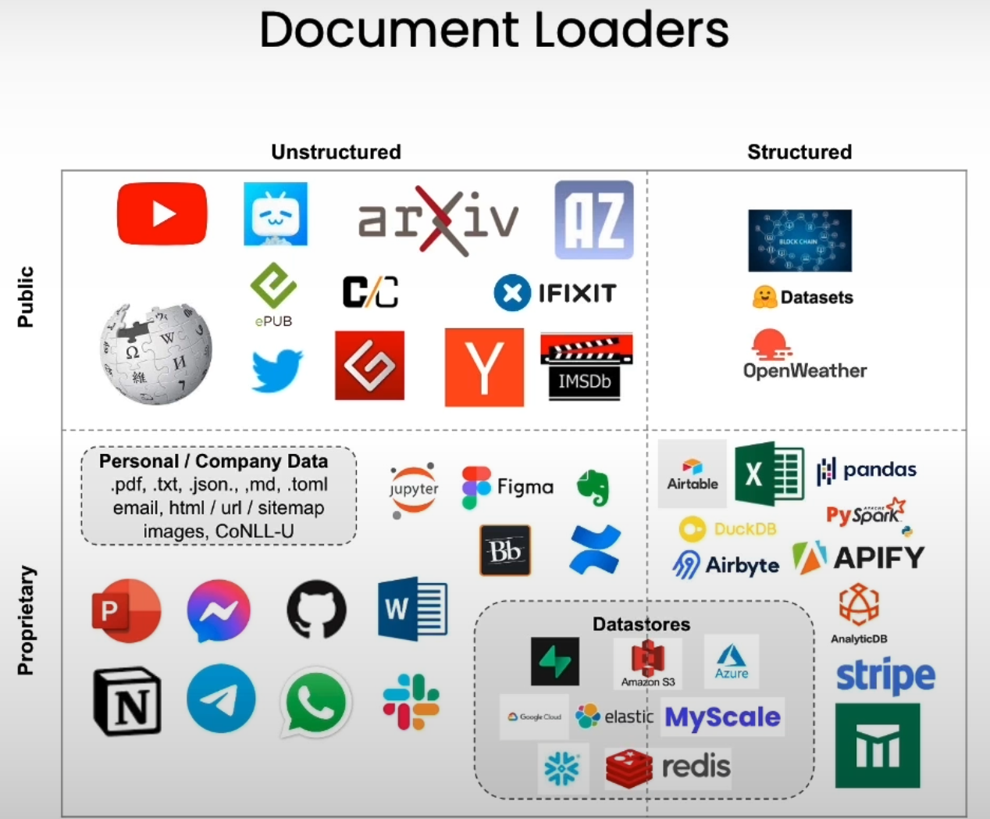
Components – Retrieval (RAG)

Slide 10
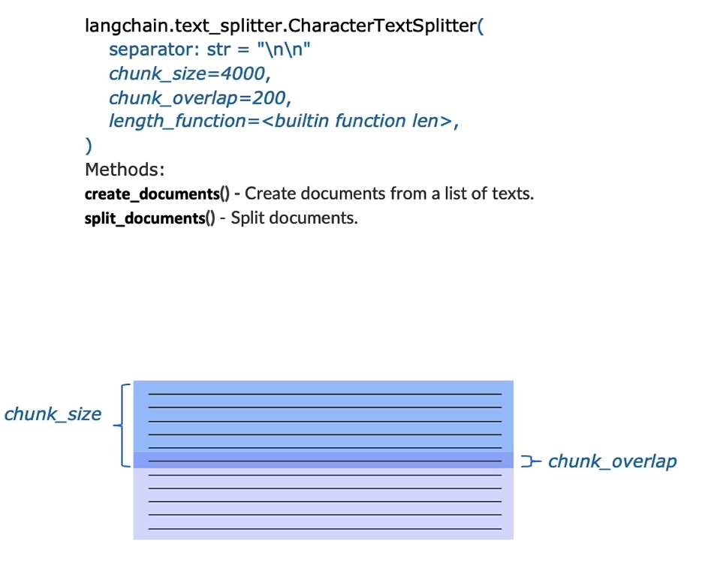
Components – Retrieval (RAG)
Text Splitters
Playground - https://langchain-text-splitter.streamlit.app/

Slide 11
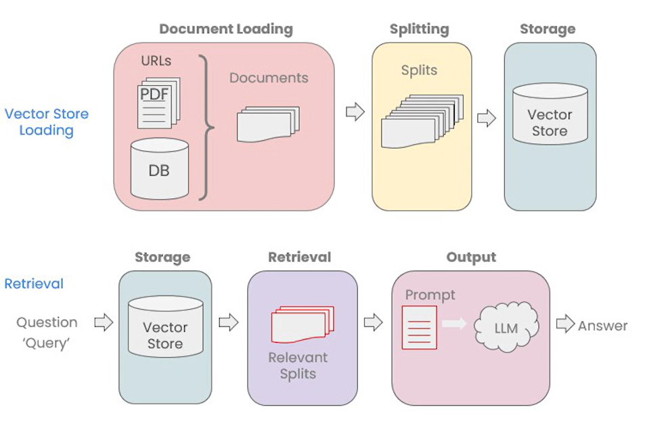
Components – Retrieval (RAG)

Slide 12
DEMO

Slide 13

DEMO – Chat with a website (Video)
Press Play

Slide 14
Use Cases
Documentation - https://python.langchain.com/v0.2/docs/how_to/#use-cases

Slide 15
USE CASES
Retrieval Augmented Generation (RAG)
Extraction
Chatbots
Query Analysis
Q & A over SQL + CSV
Q & A over graph database

Slide 16
Other Common Components
Memory
Tools

Slide 17
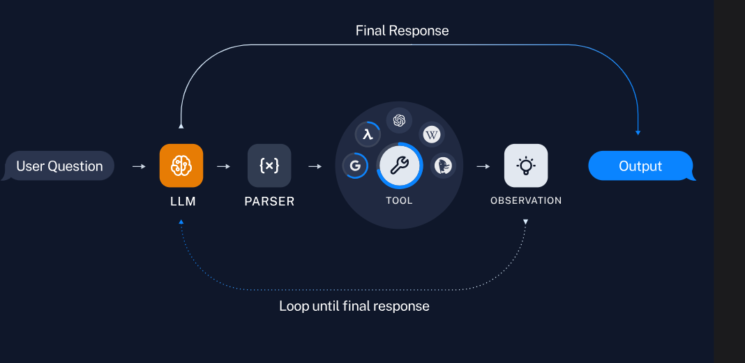
Agents - LangGraph
Agents use a language model as a reasoning engine

Slide 18
Resources
Follow LangChain on Social Media to stay updated – Linkedin, Youtube, Blog, Harrison Chase
Build with LangChain – Link
Website - https://www.langchain.com/
Deeplearning.AI x LangChain Courses
LangChain for LLM Application Development – Link
LangChain Chat with your Data – Link
Evaluating LLM Applications - LangSmith In-depth Platform Overview
Sequoia Capital - LangChain’s Harrison Chase on Building the Orchestration Layer for AI Agents
https://www.youtube.com/watch?v=6XZLoW0-mPY&t=918s
Chat with websites Youtube Tutorial by Alejandro - Link

Slide 19
THANK
YOU

